Slide 1
Ethiopia AHLE & Attribution Process Overview
Legend
<base folder>
Attribution_experts
_smallruminants.csv
AHLE scenario parameters SMALLRUMINANTS.xlsx
Run AHLE with control table
_SMALLRUMINANTS.R
ahle_ <scenario> .csv
/Program outputs/ahle SMALL RUMINANTS
File
Attribution_experts
_cattle.csv
Attribution function.R
AHLE Scenario parameters CATTLE.xlsx
Run AHLE with control table_CATTLE.R
ahle_ <scenario> .csv
/Program outputs/ahle CATTLE
R Program
Attribution_experts
_chickens .csv
/Code and Control Files
Python Program
AHLE Scenario parameters POULTRY .xlsx
Run AHLE with control table _ POULTRY.R
ahle_ <scenario> .csv
/Program outputs/ahle POULTRY
/Code and Control Files
/Code and Control Files
2_process_simulation_results_ standalone.py
ahle_all_ scensmry_ ahle.csv
ahle_all_ withattr.csv
3_run_attribution_ standalone.py
1_run_ahle_ simulation_ standalone.py
/Code and Control Files
/Code and Control Files
/Program outputs
ahle_all_ summary2 .csv
/Code and Control Files
Exchange Rate (Birr/USD)
ahle_all_ stacked.csv
Dashboard
/Data/worldbank
_inflation
_exchangerate/
/Program outputs
All stored in GBADs Liverpool github repository (https://github.com/GBADsInformatics/GBADsLiverpool), Ethiopia Workspace folder

Slide 2
Requirements to run the code
The following software must be installed on the same machine:
R version 4.0 or later with the following packages:
Mc2d
Truncnorm
Readxl
gtools
Python version 3.6 or later with the following packages:
Os
inspect
Subprocess
numpy
Pandas
pickle

Slide 3
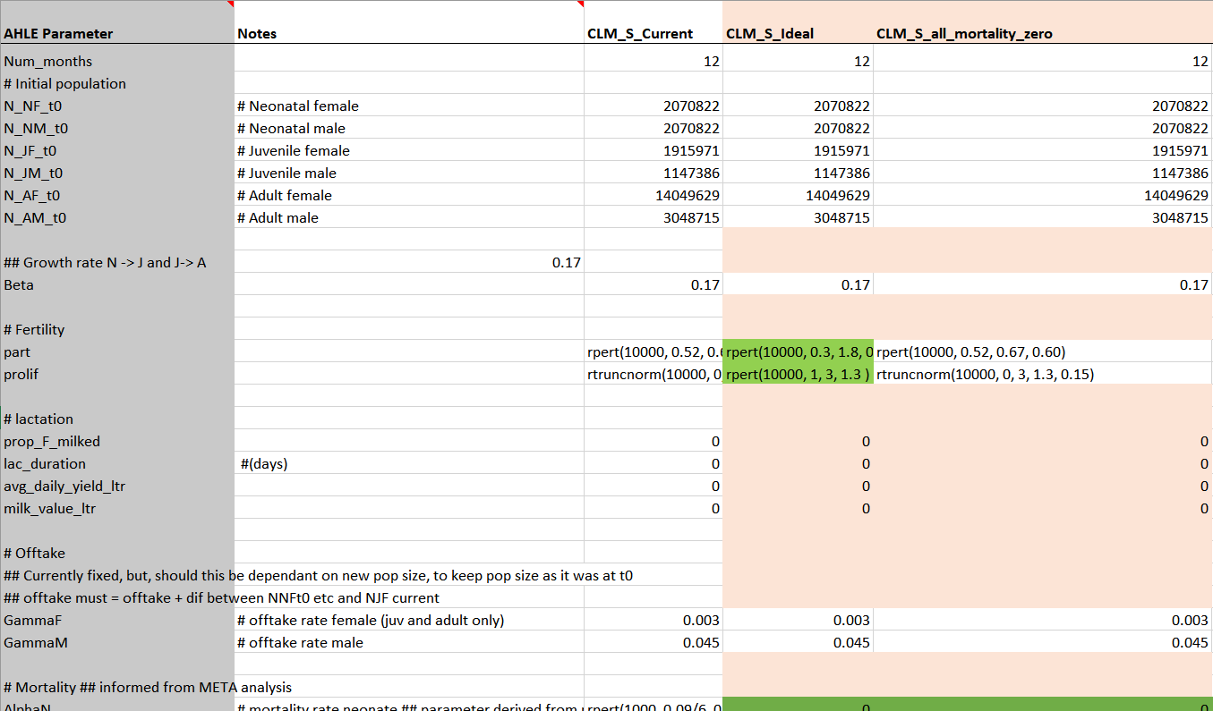
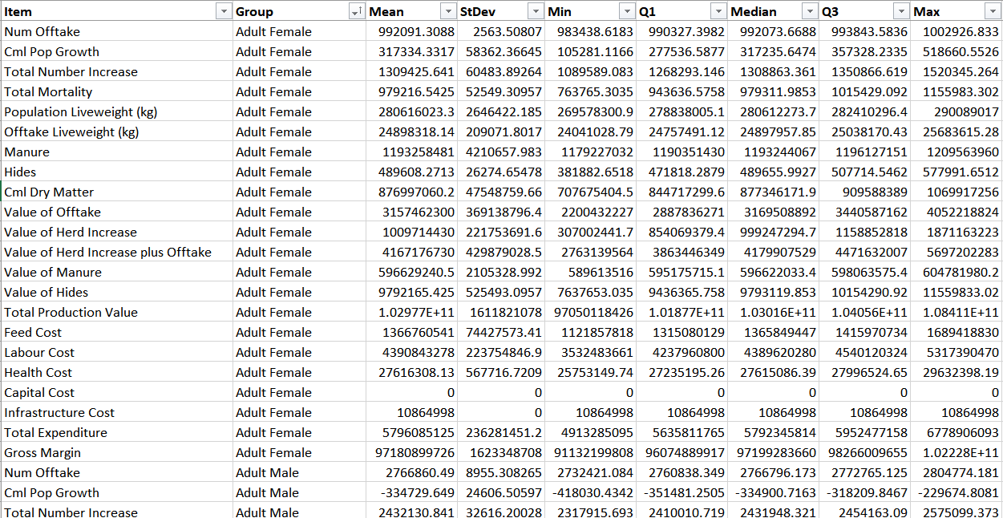
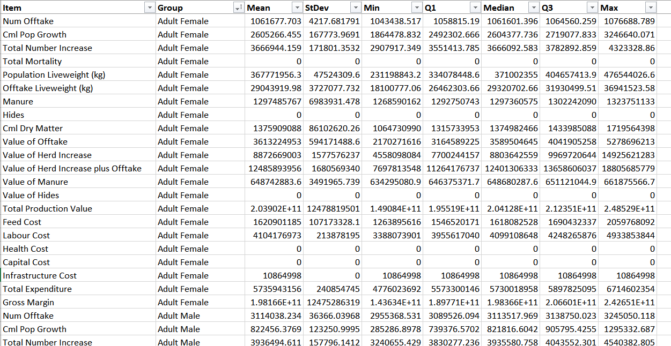
Scenario parameters and outputs
AHLE scenario parameters.xlsx
Ahle_CLM_S_Current.csv
Ahle_CLM_S_Ideal.csv

Slide 4
1_run_ahle_ simulation_standalone.py
Call compartmental model simulation function (Run AHLE with control table model.R) for each species, passing the appropriate AHLE scenario parameter file

Slide 5
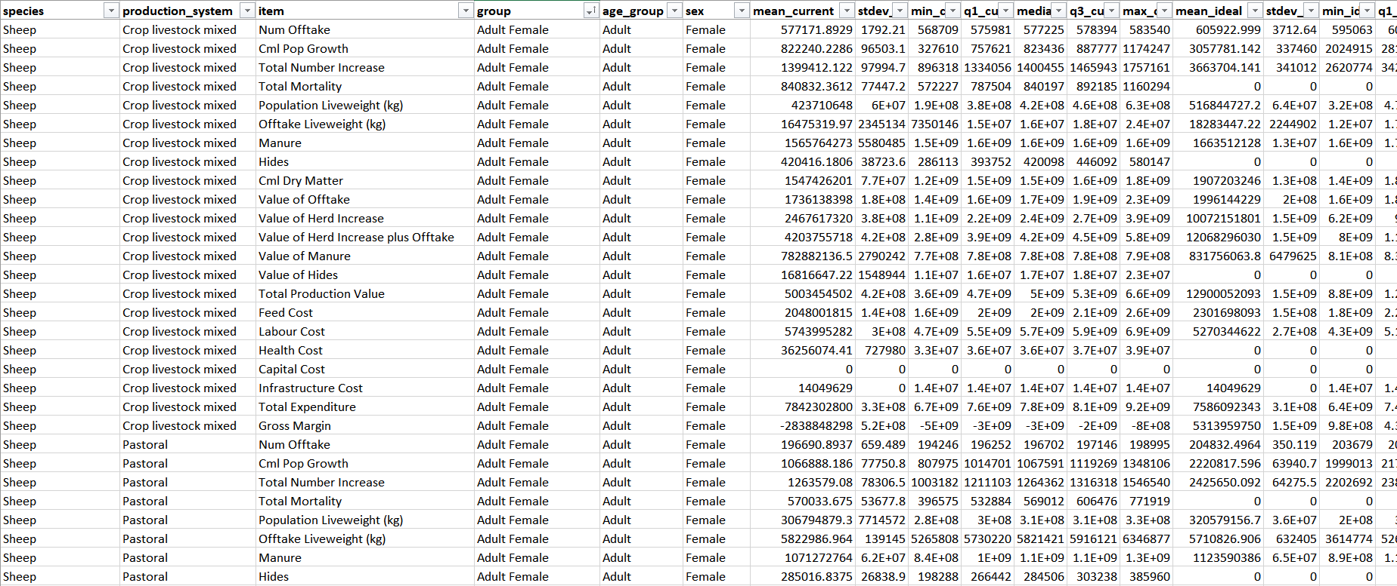
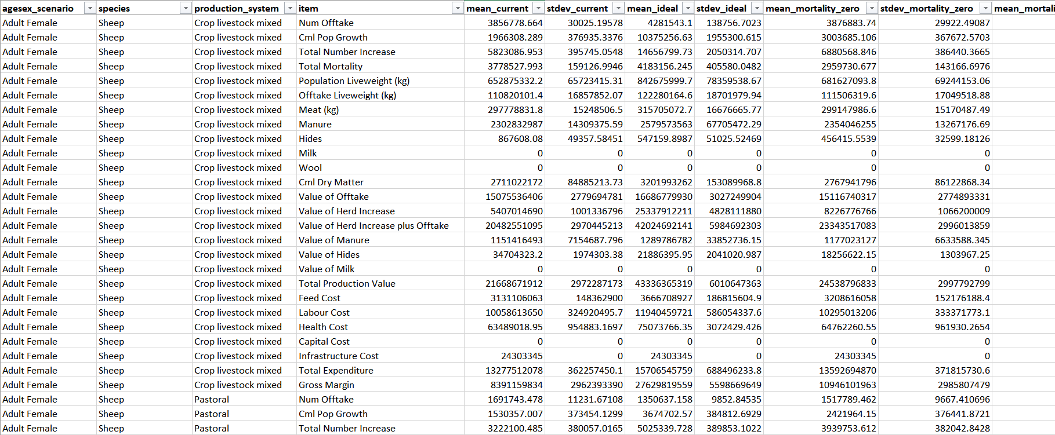
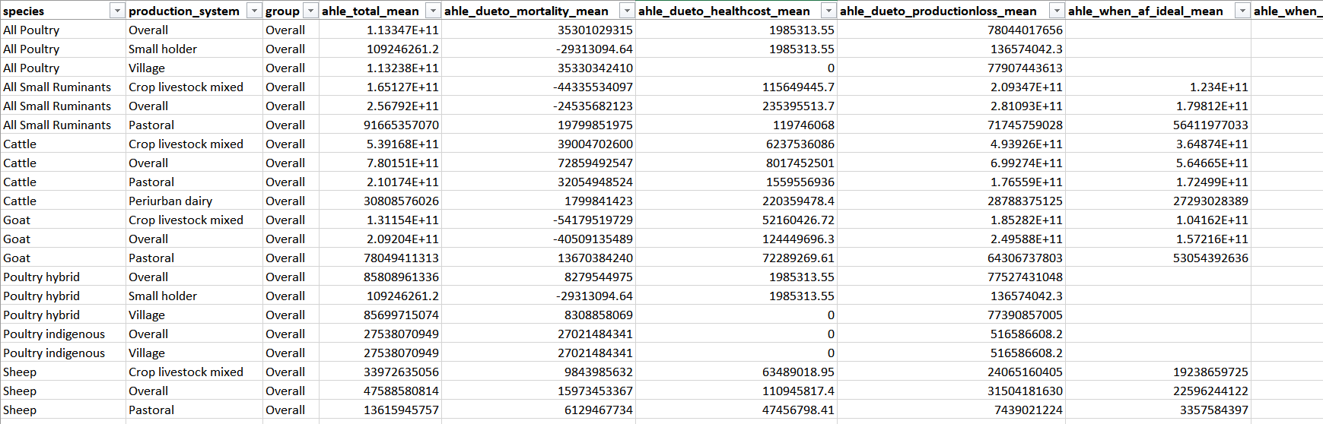
2_process_simulation_results_standalone.py
Ahle_all_stacked.csv
Steps
Combine outputs from all scenarios into a single file [ahle_all_stacked.csv]
Create species summaries (e.g. All Poultry), add currency conversion, and structure to enable comparison of individual production and cost items between scenarios [ahle_all_scensmry.csv]
Create simplified summary of AHLE for each scenario using system total gross margin [ahle_all_summary2.csv]
Ahle_all_scensmry.csv
Ahle_all_summary2.csv
ahle_total_mean = mean_ideal_gross_margin - mean_current_gross_margin
ahle_dueto_mortality_mean = mean_mortality_zero_gross_margin - mean_current_gross_margin
…
ahle_when_af_ideal_mean = mean_ideal_af_gross_margin - mean_current_gross_margin

Slide 6
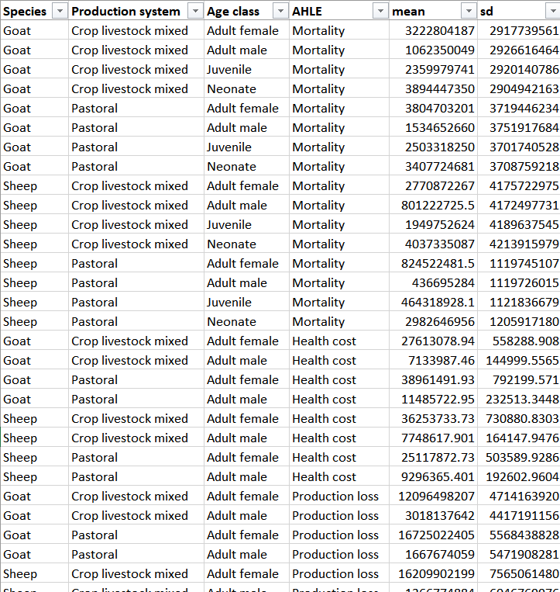
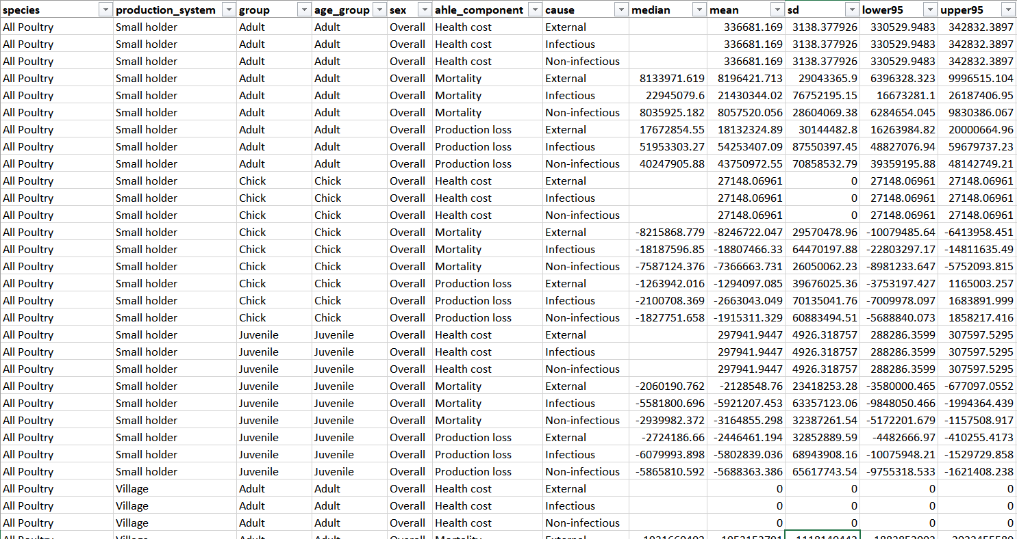
3_run_attribution_standalone.py
Ahle_all_forattr.csv
Split ahle_all_scensmry by species and restructure for attribution code [ahle_all_forattr.csv]
Call attribution function (Attribution function.R) for each species
Combine results for all species, add placeholder for health cost attribution, add currency conversion, write CSV [ahle_all_withattr.csv]
Note “Age Class” in this data designates the scenario being described and comes from “agesex scenario” in ahle_all_scensmry. The corresponding AHLE is based on the system total gross margin for that scenario.
Ahle_all_withattr.csv

